Slide 1
NT21

Slide 2
Week 1 : Introduction (Networks, Layered Model, Linux) Week 2 : IP Protocol, IP Addressing, IP Subnets , ARP, Netkit Week 3 : IP Routing, ICMP Week 4 : TCP/UDP Week 5 : Sockets Week 6 : NAT, DHCP, DN Week 7 : Repetition
Program

Slide 3
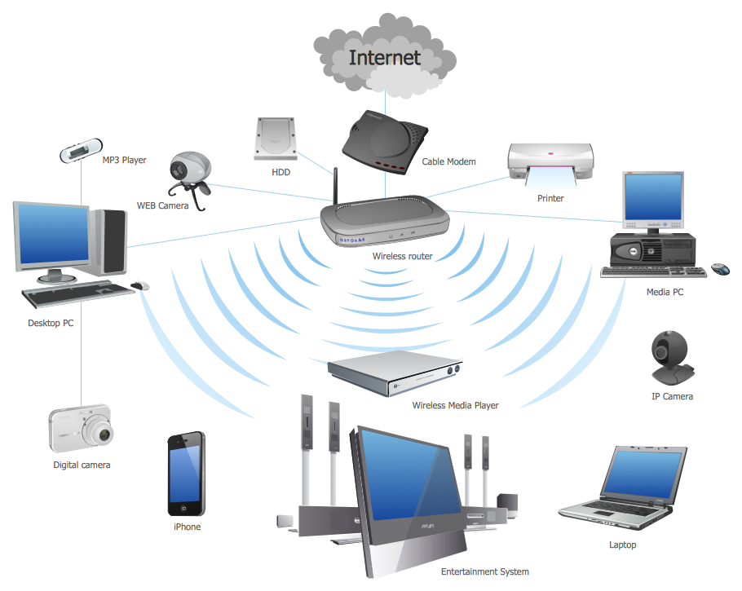
What Is a Computer Network ?
Networking technology is about
NNetworking technology is about
Networking
The internet
The home network
Configuration of networks and diagnostics
Networking model (tcp/ip model)
etworking
The internet
The home network
Configuration of networks and diagnostics
Networking model (tcp/ip model)

Slide 4
How Do All These Devices Communicate ?
https://www.youtube.com/watch?v=zyL1Fud1Z1c

Slide 5


Layered Communication
Layer 5
Layer 5
Layer 4
Layer 4
Communication SW/HW
Protocol
Layer 3
Communication SW/HW
Layer 3
Layer 2
Layer 2
Service
Layer 1
Layer 1
Transmission Medium

Slide 6
Layered Communication: TCP/IP Protocols Overview
Application Layer
HTTP
DNS
FTP
DHCP
DHCP
Telnet
SMTP
Transport Layer
TCP
UDP
Network Layer
IP
DataLink Layer
Ethernet
Wifi
Bluetooth
Physical Layer
Ethernet
Wifi
Bluetooth

Slide 7
Layered Communication: Encapsulation
Layer 5
Layer 5
Layer 4
Layer 4
Layer 3
Layer 3
Layer 2
Layer 2
Layer 1
Layer 1
Transmission Medium
1100101010001…

Slide 8
Layered Communication: TCP/IP Model Layers
Layer Function
Application Layer
Interface to User Application
Application Layer
Transport Layer
Peer to Peer Application Communication
Transport Layer
Network Layer
Host to Host Communication/Routing
Network Layer
DataLink Layer
Hop to Hop (Neighbour) Communication
DataLink Layer
Physical Layer
Interface to Physical Medium
Physical Layer
Transmission Medium

Slide 9
Layered Communication: TCP/IP Addressing
Addressing
Application Layer
Application specific: e.g. For HTTP
URL “www.google.com”
Application Layer
Transport Layer
Ports : e.g. For HTTP port 80
Transport Layer
Network Layer
IP Address : e.g. 192.168.1.2
Network Layer
DataLink Layer
MAC Address : e.g. 06:84:F4:E2:12:22
DataLink Layer
Physical Layer
N.A.
Physical Layer
Transmission Medium

Slide 10
Layered Communication: TCP/IP and OSI Model
OSI Reference Model
TCP/IP Model
Application Layer
Presentation Layer
Session Layer
Application Layer
Transport Layer
Transport Layer
Network Layer
Network Layer
DataLink Layer
DataLink Layer
Physical Layer
Physical Layer

Slide 11


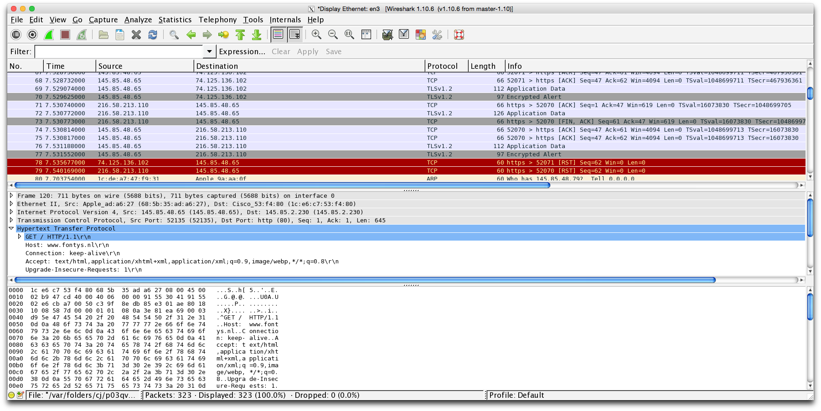
Wireshark Network Sniffing Tool

Slide 12
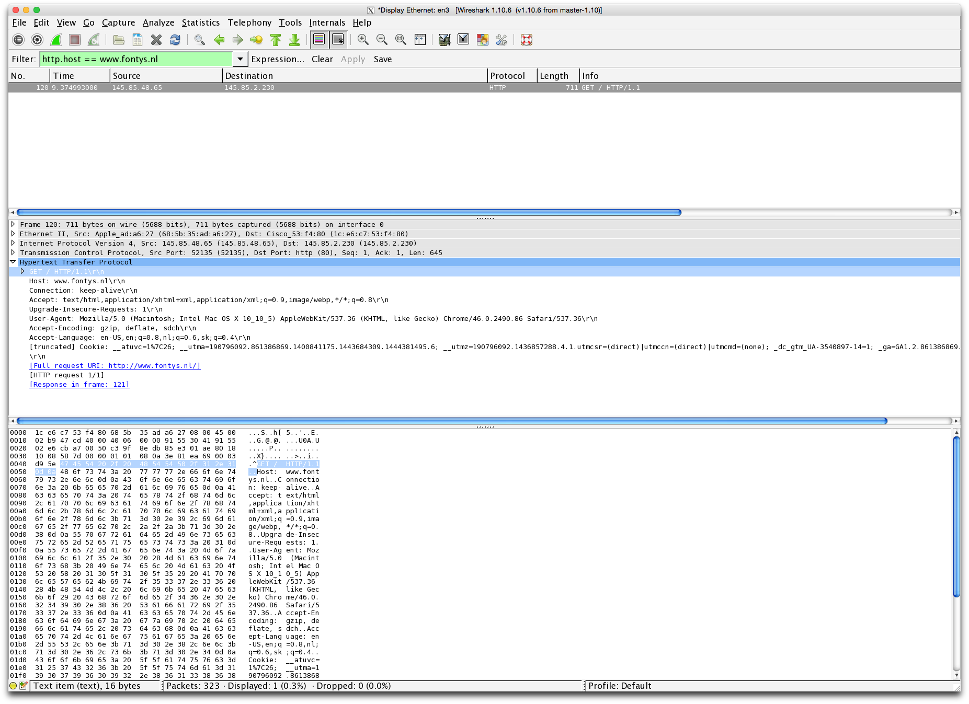
Encapsulation Example : HTTP packet in Wireshark (1)
Application Layer (HTTP)
HTTP packet in binary form

Slide 13
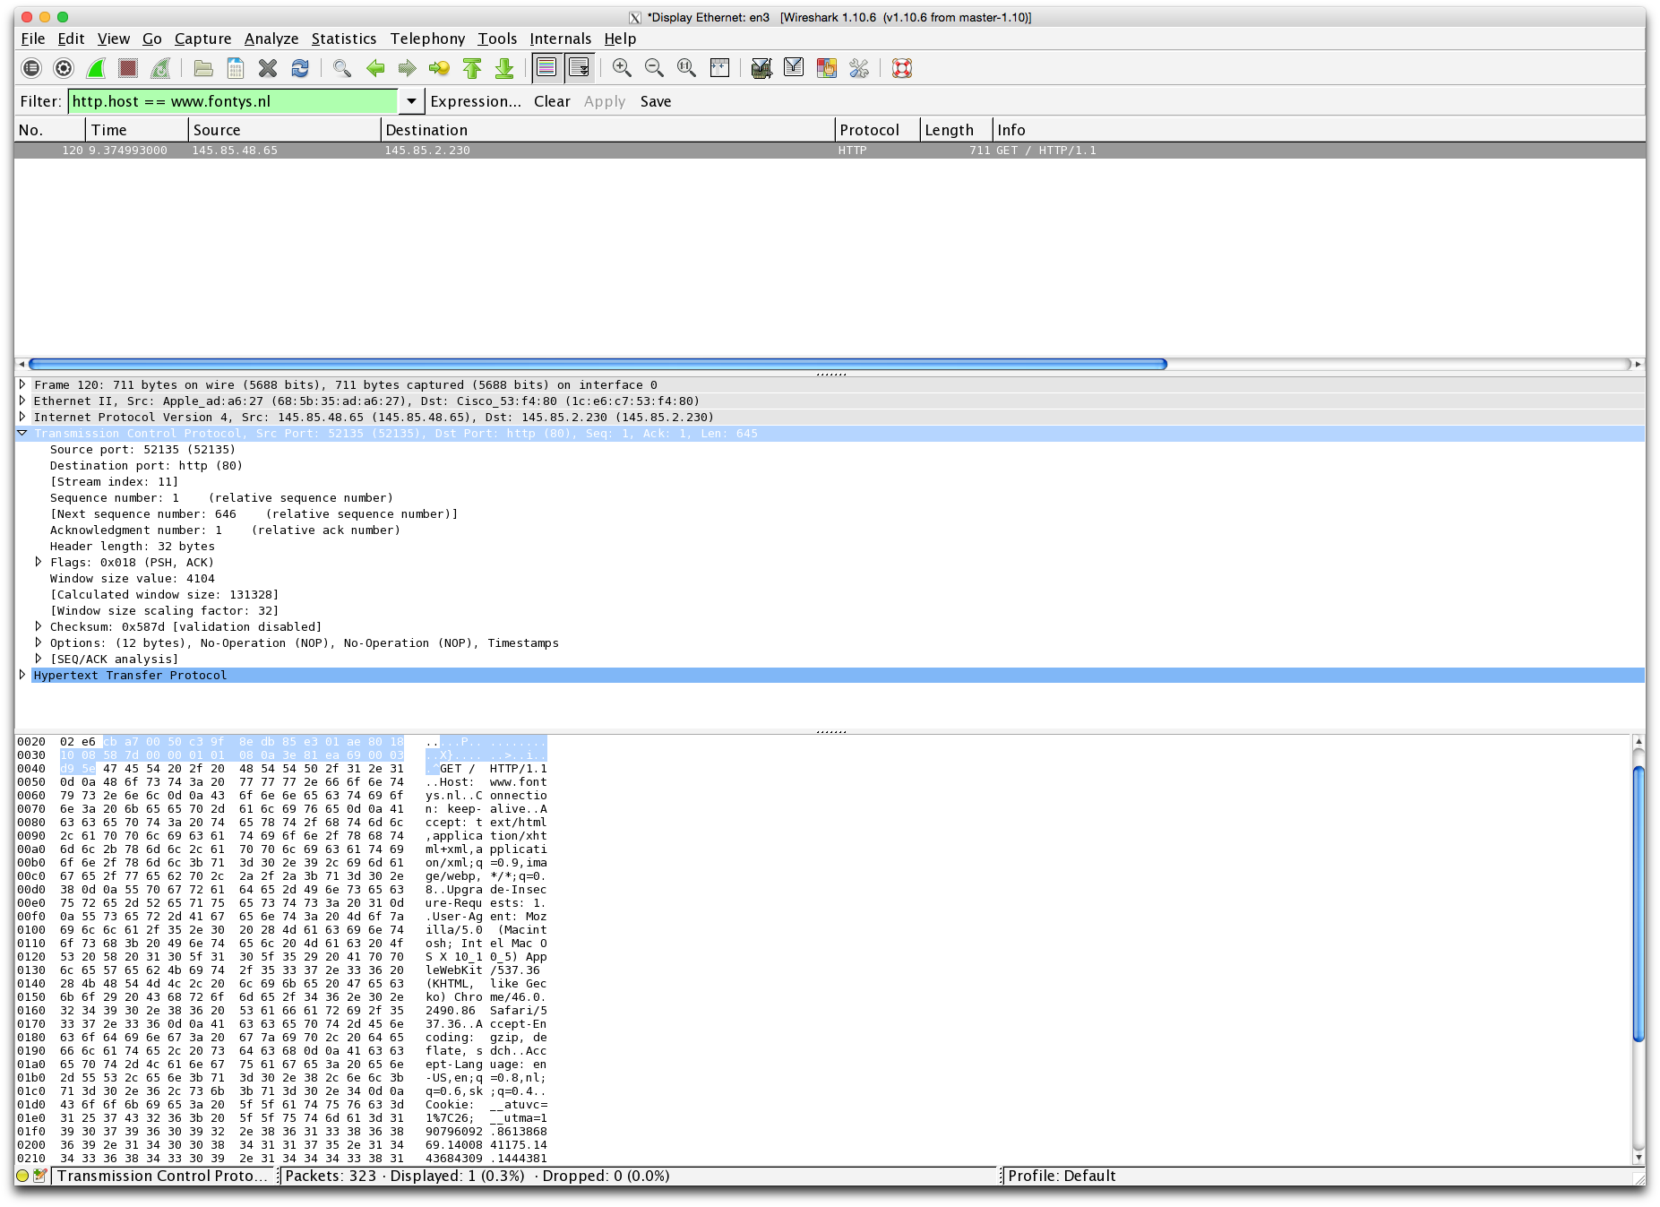
Encapsulation Example : HTTP packet in Wireshark (2)
Transport Layer (TCP)

Slide 14
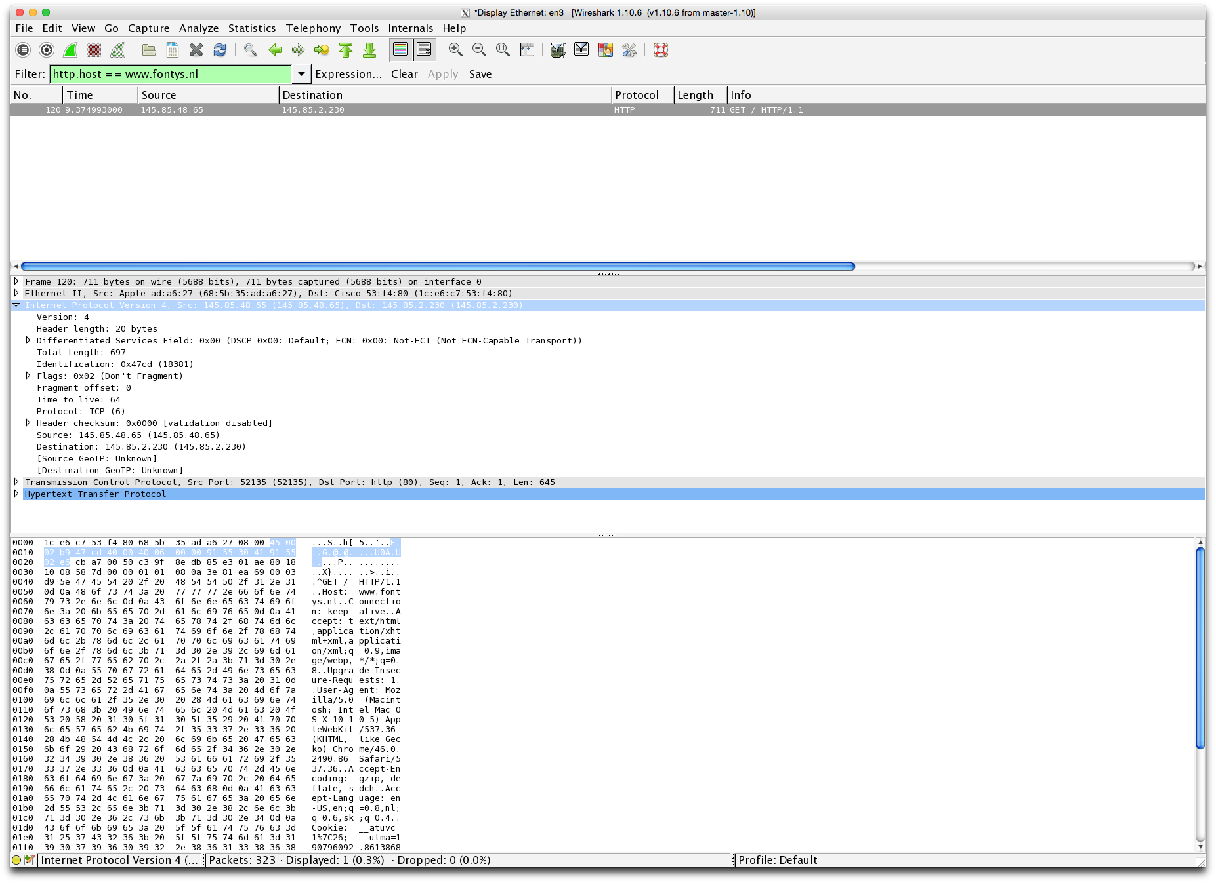
Encapsulation Example : HTTP packet in Wireshark (3)
Network Layer (IP)

Slide 15
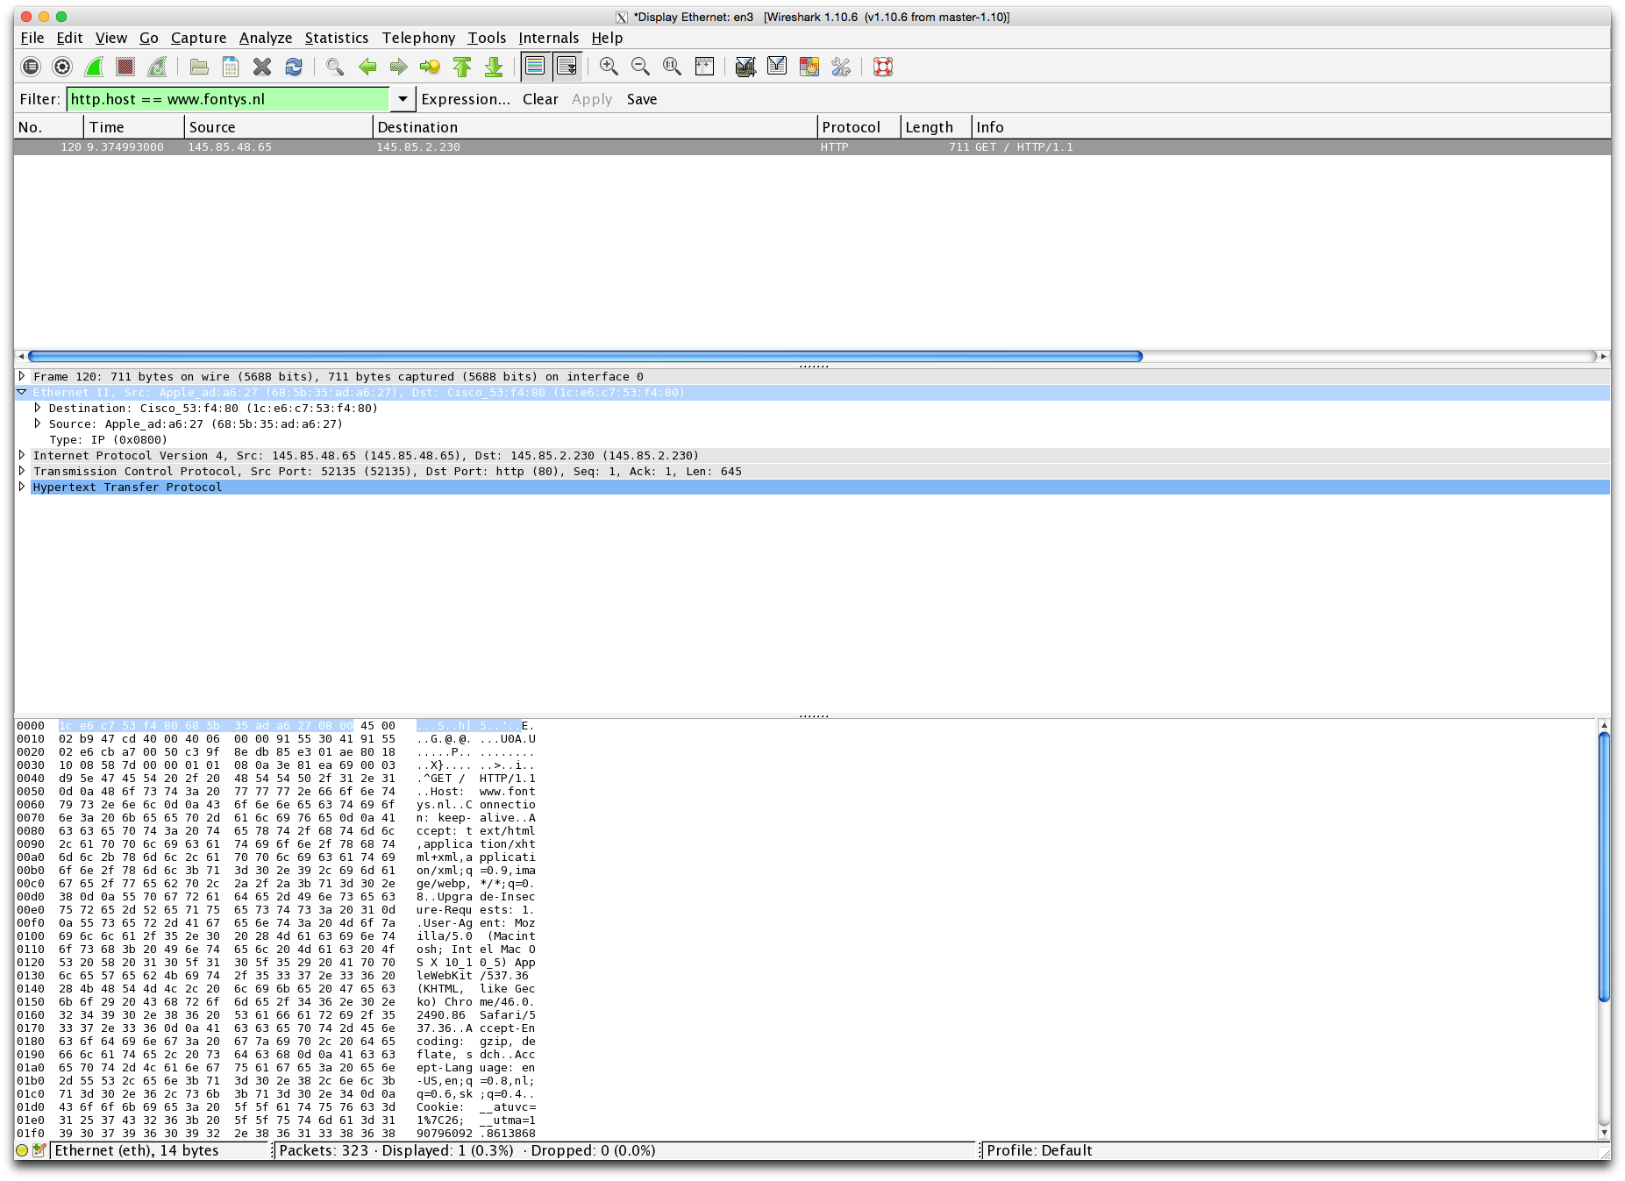
Encapsulation Example : HTTP packet in Wireshark (4)
Data Link Layer (Ethernet)

Slide 16
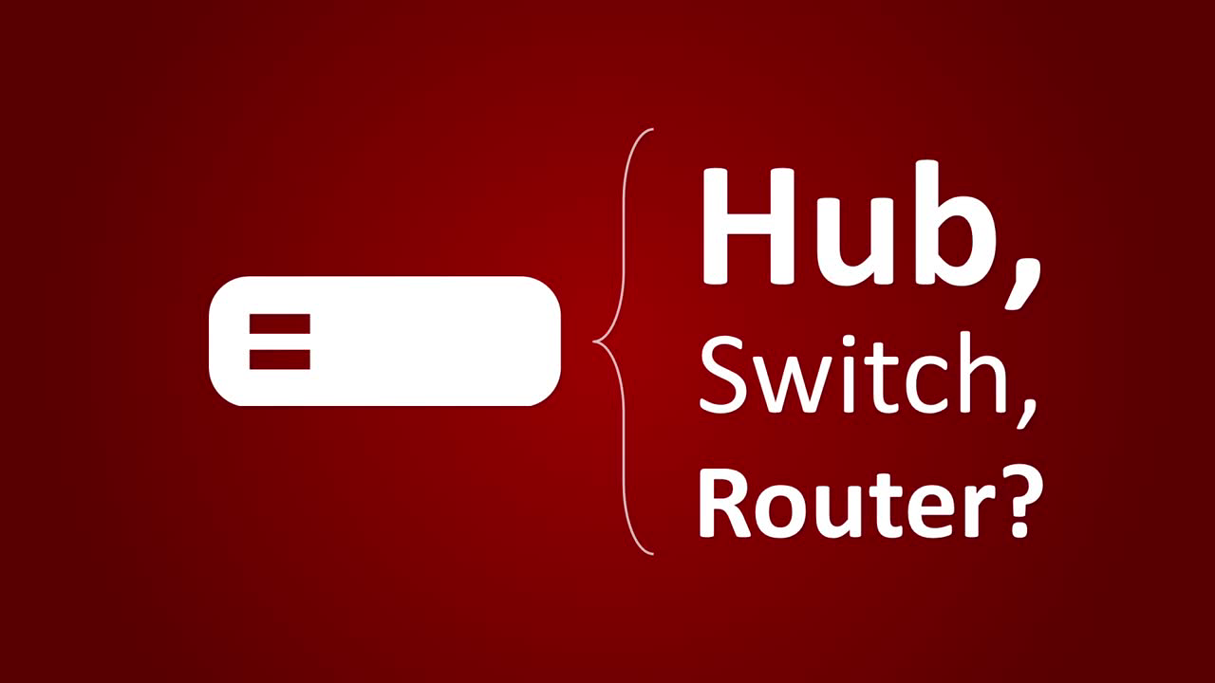

Slide 17
Notes:
Sources:
https://fossbytes.com/hub-vs-switch-comparison-and-difference/,
https://en.wikipedia.org/wiki/Linksys_WRT54G_series

Slide 18
Layered Communication: Hub, Router, Switch
Application Layer
Application Layer
Transport Layer
Transport Layer
Network Layer
Router
Network Layer
DataLink Layer
Switch
DataLink Layer
Physical Layer
Hub
Physical Layer
Transmission Medium

Slide 19
Layered Communication: Hub, Router, Switch
Host
Host
Router
Router
Application Layer
Hub
Switch
Application Layer
Transport Layer
Transport Layer
Network Layer
Network Layer
Network Layer
Network Layer
DataLink Layer
DataLink Layer
DataLink Layer
DataLink Layer
DataLink Layer
Physical Layer
Physical Layer
Physical Layer
Physical Layer
Physical Layer
Physical Layer

Slide 20

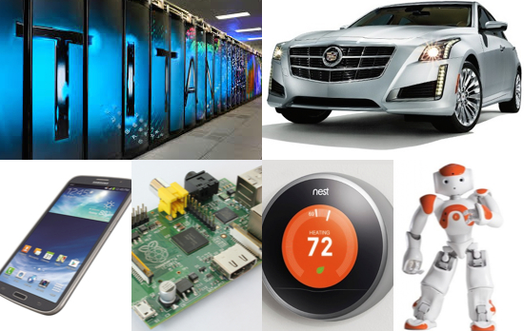
Linux
From smartphones to cars, supercomputers and home appliances,
the Linux operating system is everywhere.

Slide 21
Linux Advantages
Free
Secure
Stable
Good hardware support
Flexible and configurable
… and many more

